Slide 1
TheCollegeLand
Here is where our presentation begins

Slide 2
TABLE OF CONTENTS
01
04
About the Project
Sneak Peek
02
05
Major Requirements
Project Stages
03
06
project Goals
Our Team

Slide 3
ABOUT THE PROJECT
We are working on this project by making a website where the students who have completed their HSC board exams and have passed the CET exam can find a suitable college for them within just a few minutes.

Slide 4

Why we choose this project

Slide 5

AWW YEAH ! CONFUSE RAY !

Slide 6
WHAT WE ARE WORKING ON
SECURE
ACCESSIBLE
FAST AND RELIABLE
Our website is fully secured and users information is safe with us.
Our website is friendly and easy to use.
This site is fast working and trustworthy.

Slide 7
—SOMEONE FAMOUS
“The only way to do great work is to love what you do. If you haven’t found it yet, keep looking. Don’t settle.”

Slide 8
DISADVANTAGES :
LACK OF CLASSIFICATION
PROGRAMMING MISTAKES
LACK OF ADAPTABILITY

Slide 9
FUTURE
COLLEGES PLACES
MORE CLASSIFIED DATA
ADAPTABILITY

Slide 10
MAJOR REQUIREMENTS
IMAGES
USER EXPERIENCE
INFORMATION
We Collected various images , graphs and icons from different sources.
Due to this project we have gained experience in HTML , CSS and JavaScript.
Several information about all the different colleges, courses and cutoffs etc. was required.

Slide 11
OUR GOALS
EXPANSION
POSITIONING
USABILITY
We want to expand our project by adding more courses, colleges and a lot more choices for students to have all types of career opportunities.
After a lot of hardwork, dedication and modification our team will surely make at the top as the best site for students career guidance.
We want every student to be able to use our site easily and affordably

Slide 12
PROJECT STAGES
STEP 2
STEP 1
STEP 3
We have prepared a very basic plan and design of our website
Our team has gathered every information required for the project
Implementing the project

Slide 13
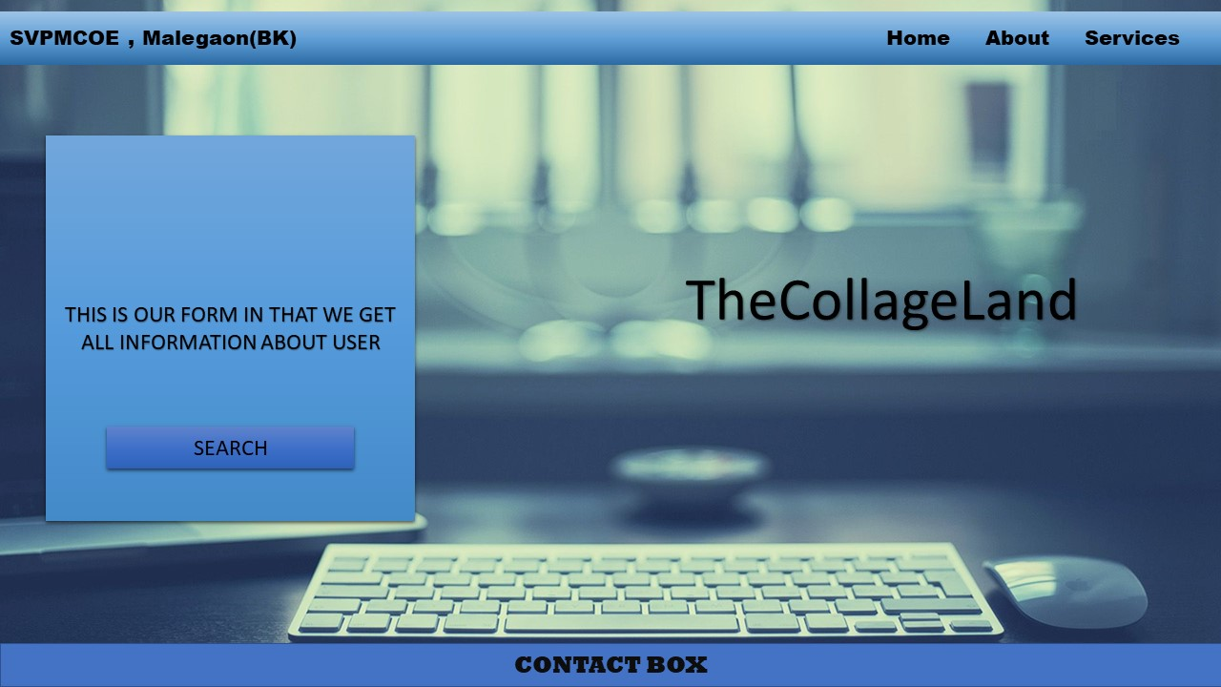
DESIGN

Slide 14
OUR TIMELINE
WEEK 1
WEEK 3
BETA
RELEASE
FINAL
VERSION
WEEK 2
WEEK 4
Gathering Information
Design
Learning skills
Implement

Slide 15



OUR PARTNERS
NIKITA
GOOGLE
RAMESHWAR
Back-end developer
Java programmer
C, C++ and python programming
Front-end developer
Java programmer
C, C++ and python programming
Google is our most of the important source for collecting information

Slide 16
THANKS!

Slide 17
CREDITS
This is where you give credit to the ones who are part of this project.
Guidence by prof. Mhaske V.D.
Guidence by prof. Kate-Deshmukh P.N
Presentation and page Design by Nikita
Implimentation of web-page by Rameshwar

